Slide 1
Amazon’s Music Instrument Reviews
Analysis
Jason Zhang

Slide 2
Objective
To understand what people like and don’t like about the product (Music Instrument) by analyzing the reviews.

Slide 3
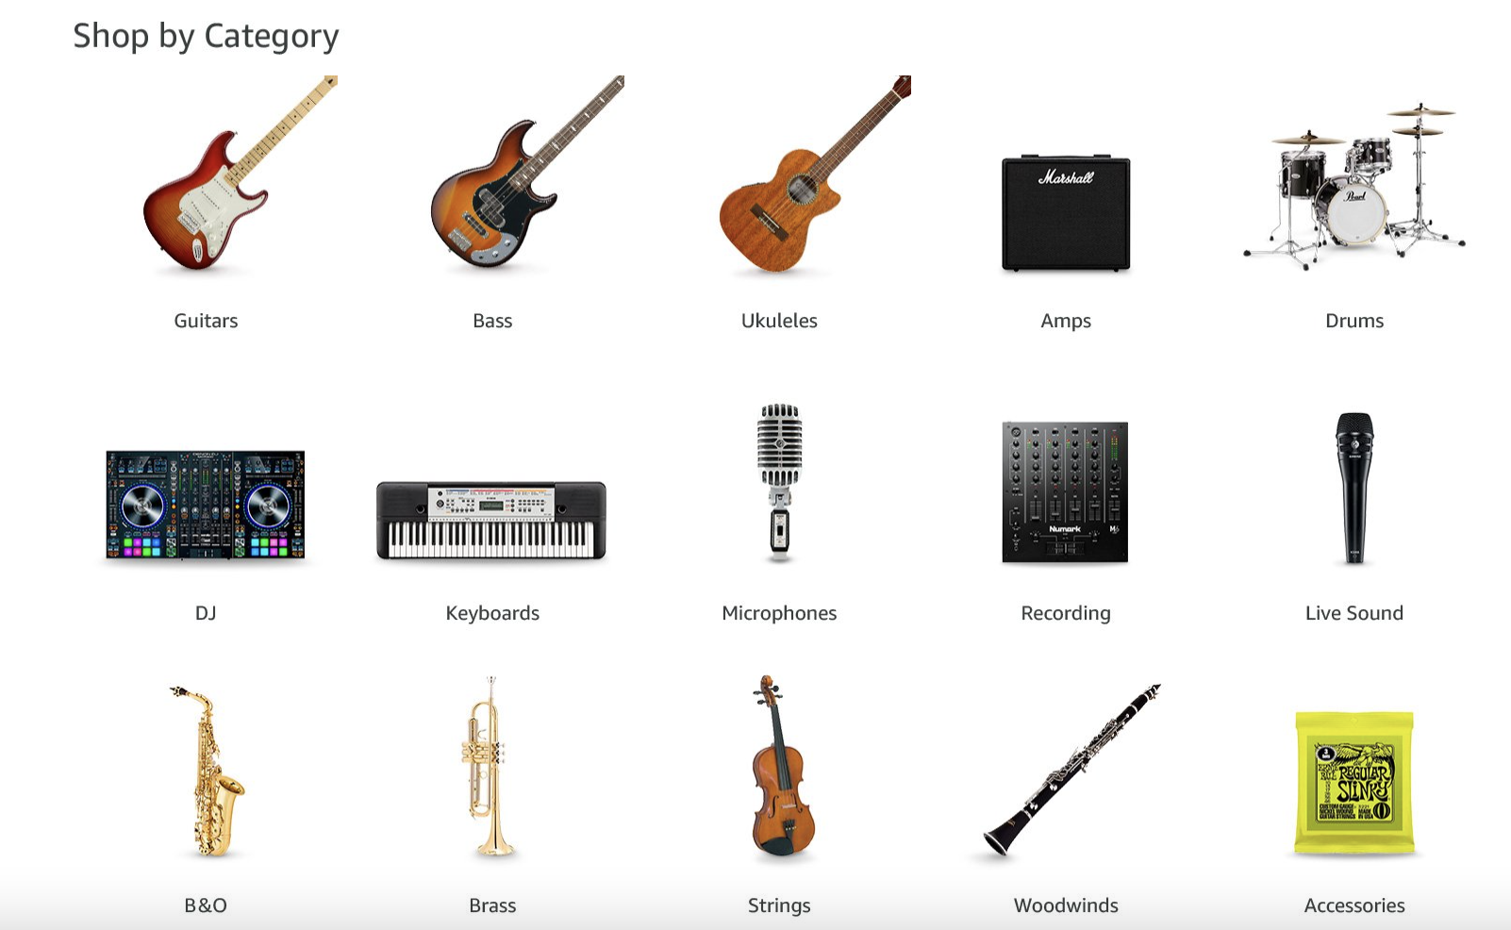

Background
Products from Amazon Music Instrument Site：
Strings (Guitar Family)
Brass (Saxophones)
Percussion (Drums)
Woodwinds (Clarinet)
Vocal (Microphones)
Accessories (Cables)

Slide 4
Method of the Analysis
Data Cleaning & EDA
NLP
Unsupervised Learning
Pandas
Numpy
Seaborn
Text Cleaning
Punctuation
Stopwords
Lemmatization
Tokenization
Preprocessing
TF-IDF
PCA
PCA
Topic Modeling
LDA
NMF

Slide 5
Data - Amazon Reviews
Source: UCSD
Features:
Data Size: n = 10,261 reviews
01
General Information
ReviewerID
ProductID
Reviewer Name
02
Review Text
Review Summary
Review Details
03
Review Rating
Rating ( 1 - 5 stars)
Helpfulness
04
Review Time
Timestamp of the Review

Slide 6
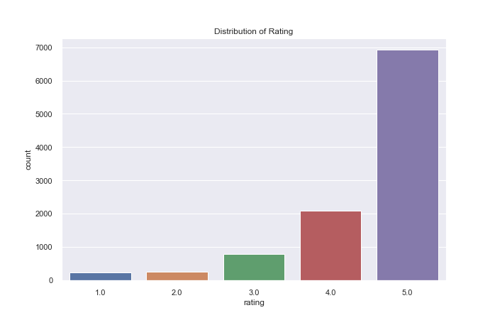
EDA - Review Distribution

Slide 7
What makes a review good/bad?
Bad Review
Good Review

Slide 8
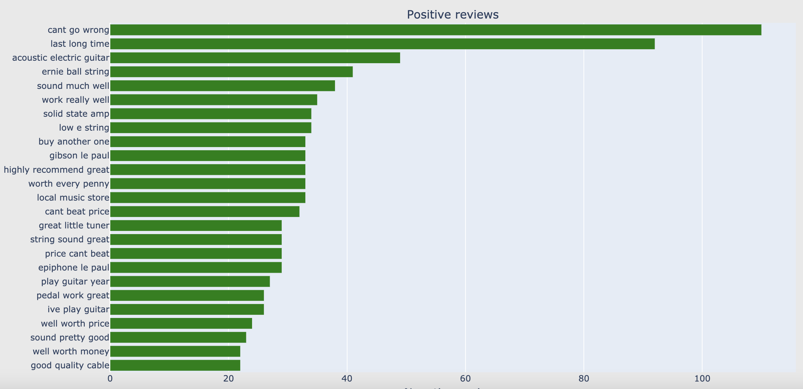
What makes a review good? (Tri-grams view)
Price
Quality
Brand
Sound
Instrument
Guitar
Amplifier

Slide 9
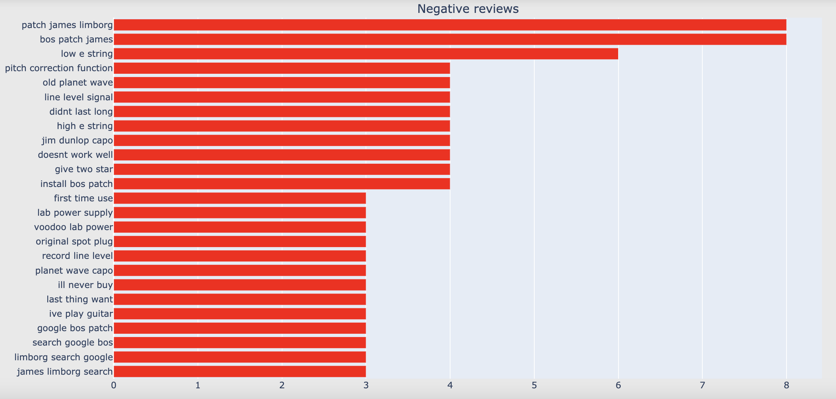
What makes a review bad? (Tri-grams view)
Competitor
Sound
Quality
Instrument
Capo
Recording
Cables

Slide 10
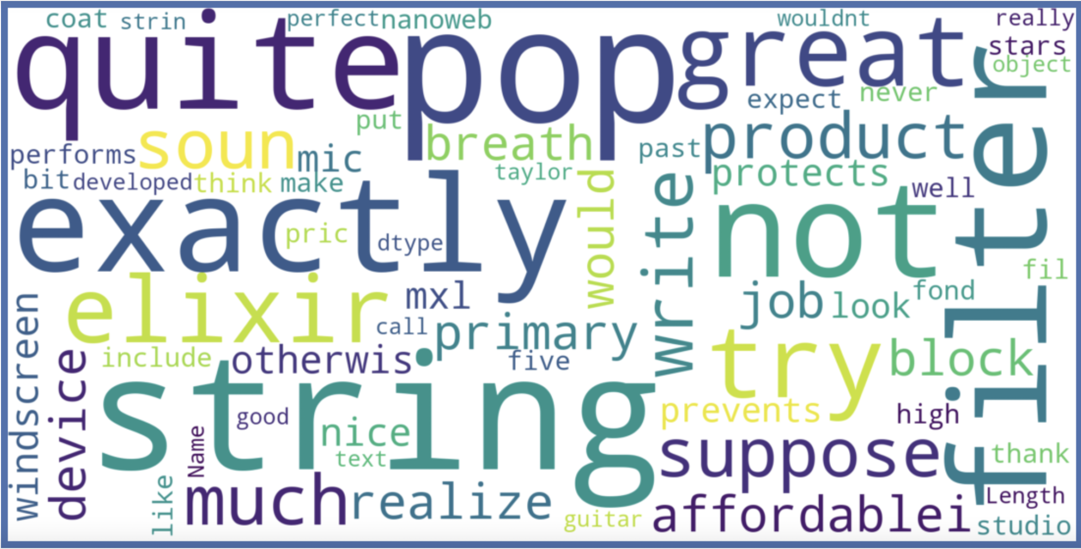
What makes a review good? (WordCloud)
Price
Quality
Sound
Look
Instrument
Guitar
Mic

Slide 11
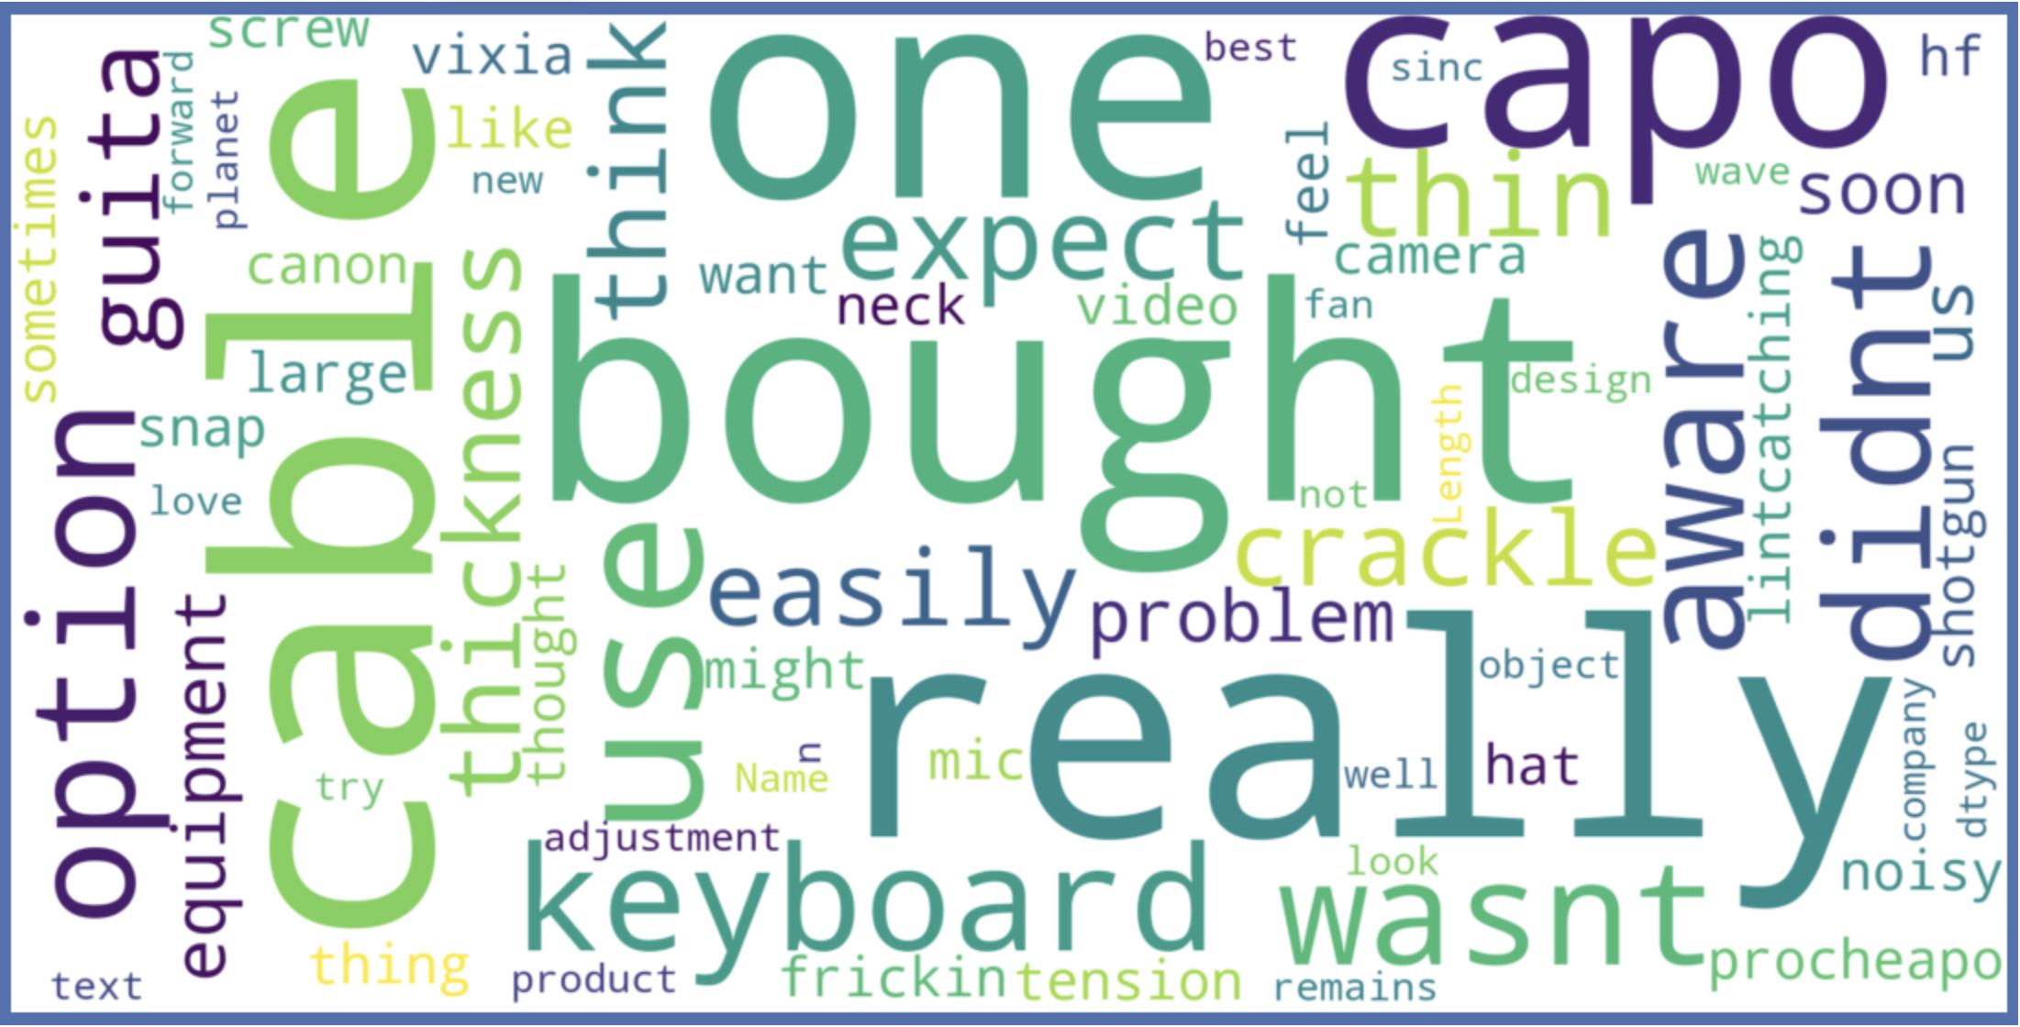
What makes a review bad? (Word Cloud)
Quality
Sound
Instrument
Guitar
Capo
Cable
Keyboard

Slide 12
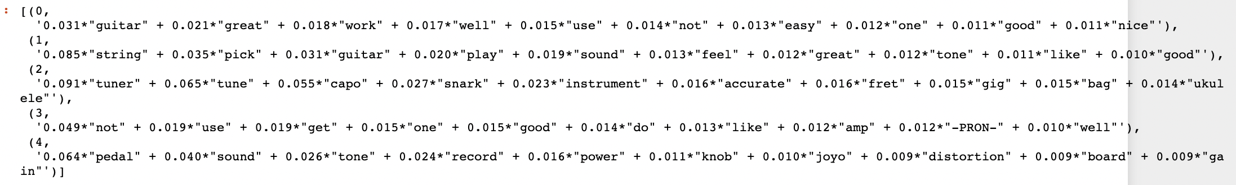
What makes a review good? (Topic Modeling-LDA)
Topic 0 - Guitar Quality
Topic 1 - Guitar Sound
Topic 2 - Capo for Tuning
Topic 3 - Amplifier Pronounced
Topic 4 - Recording Pedal

Slide 13
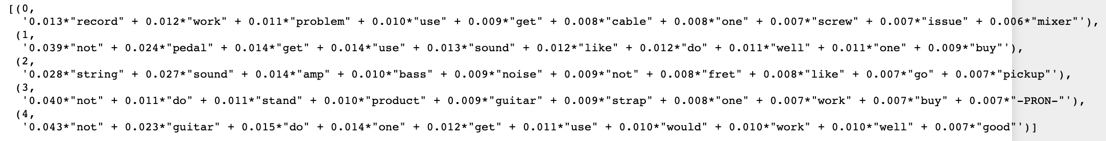
What makes a review bad? (Topic Modeling-LDA)
Topic 0 - Recording Pedal Cable
Topic 1 - Recording Pedal Sound
Topic 2 - Amplifier Sound
Topic 3 - Guitar Stand
Topic 4 - Guitar Quality

Slide 14
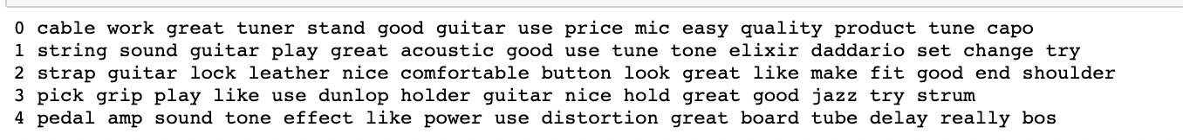
What makes a review good? (Topic Modeling-NMF)
Topic 0 - Capo Tuner
Topic 1 - Guitar Quality
Topic 2 - Guitar Look
Topic 3 - Guitar Pick
Topic 4 - Pedal & Amp

Slide 15
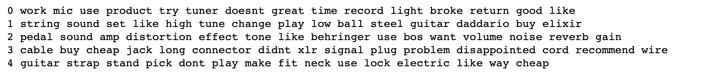
What makes a review bad? (Topic Modeling-NMF)
Topic 0 - Microphone
Topic 1 - Guitar Strings (Sound)
Topic 2 - Pedal & Amp (Sound)
Topic 3 - Cable (Connection)
Topic 4 - Guitar Stand & Strap

Slide 16
Conclusion
Good
Bad
Standard:
Price
Quality
Use:
Look
Sound
Connection
Fit
Guitar
Capo
Pedal
Recording Gear
Gears:
Amp
Cables
Keyboard
Straps
Specialty:
Brand

Slide 17

Future Work
More Text Cleaning and Tuning
Add Time Series
Join More Features

Slide 18
Thanks
Bad
Any questions?

Slide 19
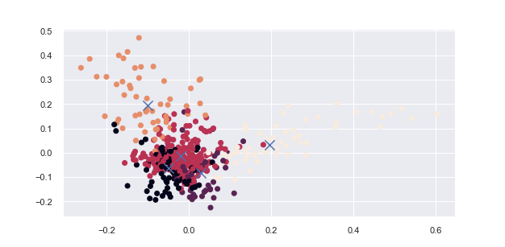
Appendix 1 - K means Bad Reviews
Silhouette Score = 0.0075

Slide 20
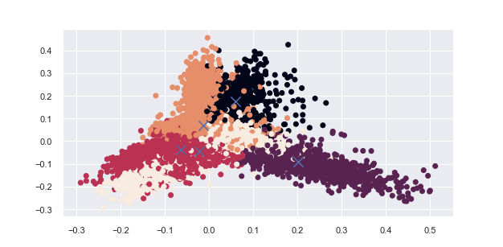
Appendix 2 - K means Good Reviews
Silhouette Score = 0.0118

Slide 21
Appendix 3 - Data Source
Description: Amazon Product Data - Music Instruments
Creator: Julian McAuley, UCSD
Link: https://jmcauley.ucsd.edu/data/amazon/

